Slide 1
Choosing the right Deep Learning Framework: A Deep Learning Approach
Nick Acosta
IBM Data Science Community

Slide 2
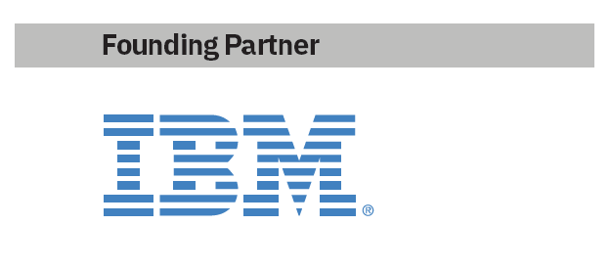






Call for Code 2019 Developer Challenge
How to get involved: www.developer.ibm.com/callforcode
View this year’s finalists: https://developer.ibm.com/callforcode/projects/
Developers… answer the call
Part of Code and Response™, this annual global developer challenge Call for Code, asks developers to create sustainable software solutions to prepare for, respond to and recover from natural disasters. The winning team receives:
A $200K cash prize
Open Source Support from The Linux Foundation
Meetings with mentors and potential investors
Solution implementation support through Code and Response™
www.developer.ibm.com/callforcall
Call for Code
challenge opens
March 25
Project Owl
Implementation
April
Cause Flash
(UN World Health Day)
April 7
Wildfire Community Preparedness Day
(+42 school event)
May 4
National Hurricane Preparedness Week
May 10
Cause Flash
(World Environment Day)
June 5
World Humanitarian Day
Aug 19
Award Event
October 13 NYC

Slide 3
Which Deep Learning Framework should I be using for neural network development?

Slide 4
Deep Learning Frameworks Advice
Content usually falls into three camps

Slide 5
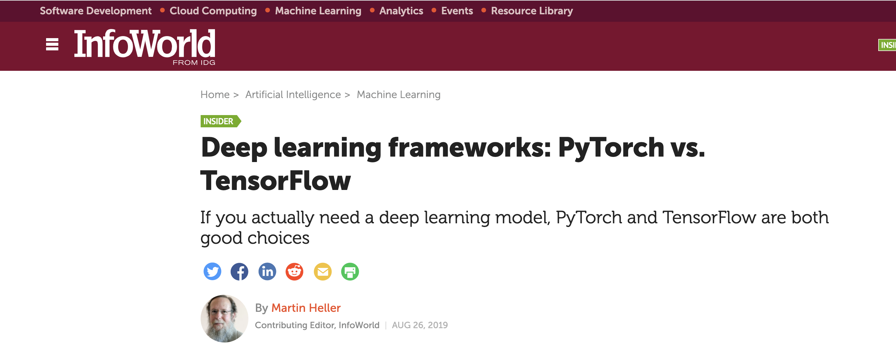
Deep Learning Frameworks Advice
Content usually falls into three camps
historical overview

Slide 6
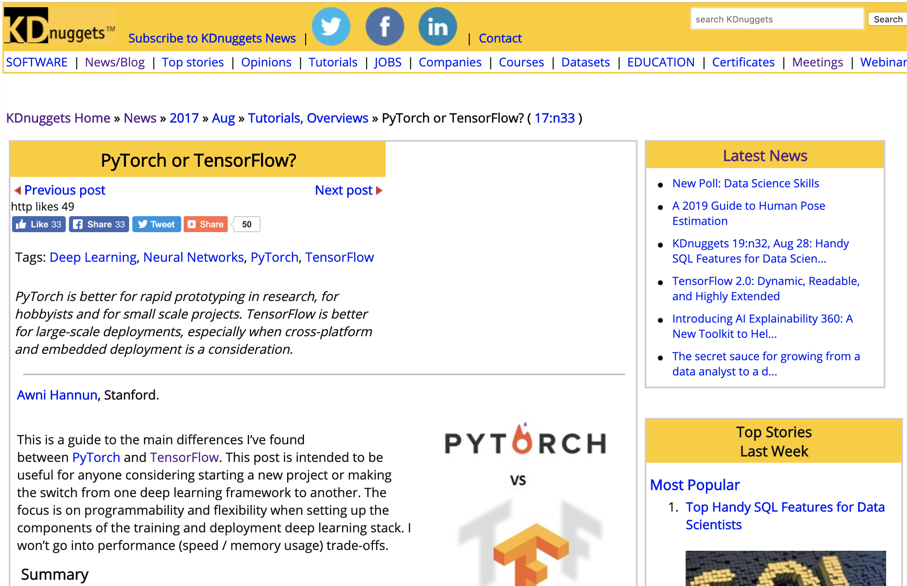
Deep Learning Frameworks Advice
Content usually falls into three camps
historical overview
explanation of differences

Slide 7
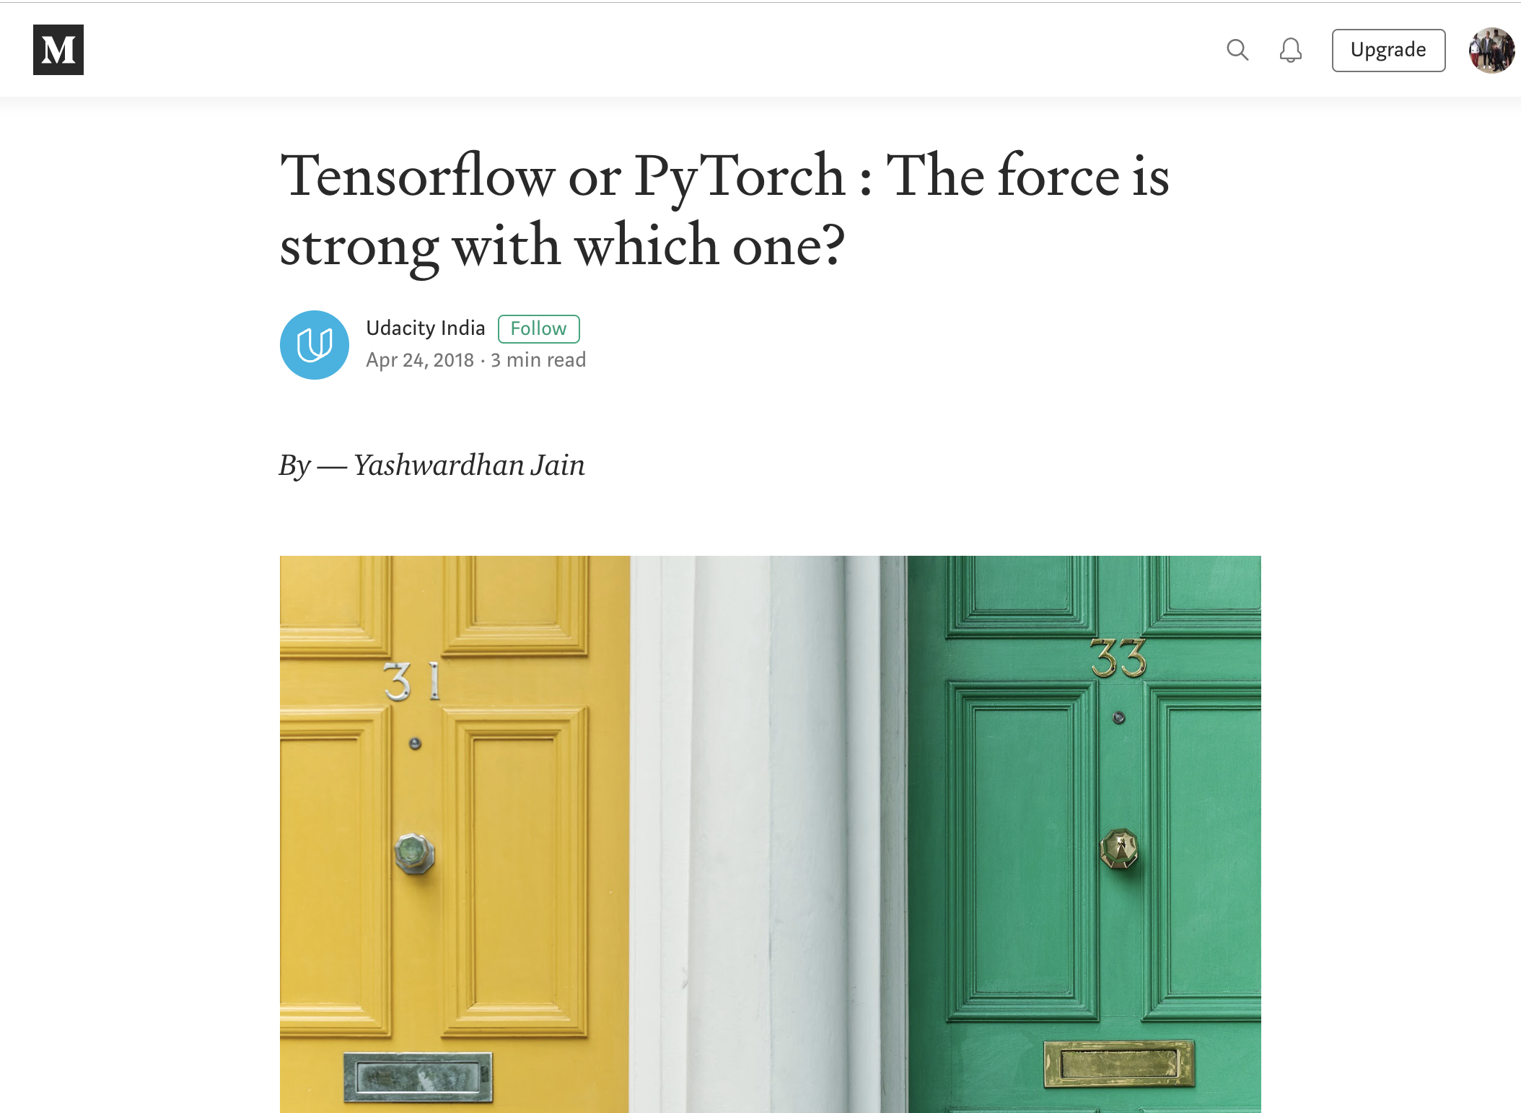
Deep Learning Frameworks Advice
Content usually falls into three camps
historical overview
explanation of differences
advisory of preference

Slide 8
Deep Learning Frameworks Advice
Content usually falls into three camps
historical overview
explanation of differences
advisory of preference
Some are combination of three, but most have an advisory voice

Slide 9
Deep Learning Frameworks Advice
Content usually falls into three camps
historical overview
explanation of differences
advisory of preference
Some are combination of three, but most have an advisory voice
prone to
subjectivity
anecdotal evidence
current state of deep learning frameworks

Slide 10
Start with the framework chosen for you via Deep Learning.

Slide 11
Agenda
Part One - Introduction 01
Call for Code 02
"Deep Learning Frameworks Advice" 04
Agenda 11
Part Two - Deep Learning Frameworks 12
Deep Learning Frameworks 13
TensorFlow 15
PyTorch 18
Part Three - Data 21
Data Source 23
Preparation for Deep Learning 36
Part Four - Models 27
Overview 28
Results 29
Part Five - Conclusion 31
Resources 32

Slide 12
Deep Learning Frameworks

Slide 13
Deep Learning Frameworks
Allow for easy construction of neural networks

Slide 14
Deep Learning Frameworks
Allow for easy construction of neural networks
Abstract away lowest level detail
Standardize commonly used neural network concepts, from components to models
Provide tooling for deployment on various hardware configurations, including GPUs

Slide 15
TensorFlow
From Google via Google Brain
Late 2015
Build for distributed computing
Tensor - default data structure
n-dimensional array
Flow - execution via computational graph
C++ (CUDA) backend
mixed frontend

Slide 16
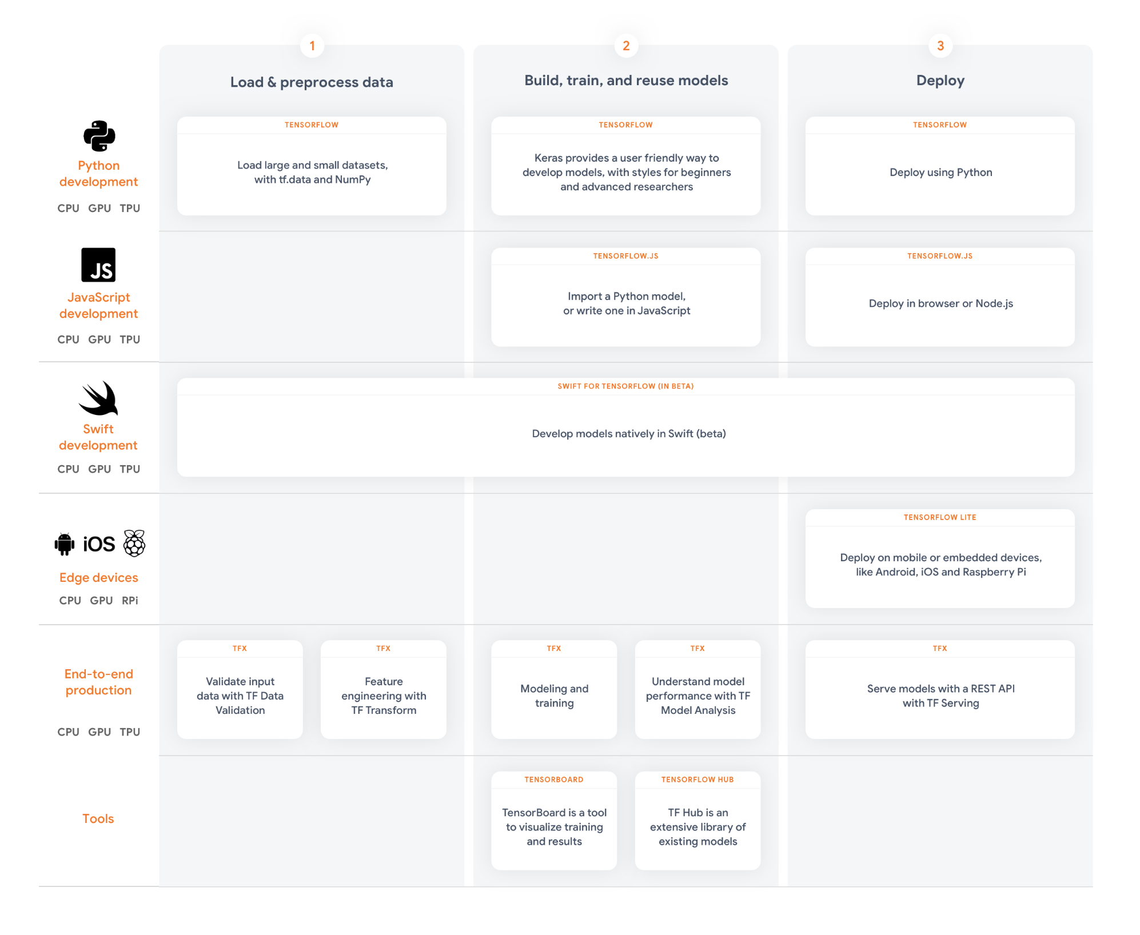
TensorFlow
From Google via Google Brain
Late 2015
Build for distributed computing
Tensor - default data structure
n-dimensional array
Flow - execution via computational graph
C++ (CUDA) backend
mixed frontend

Slide 17
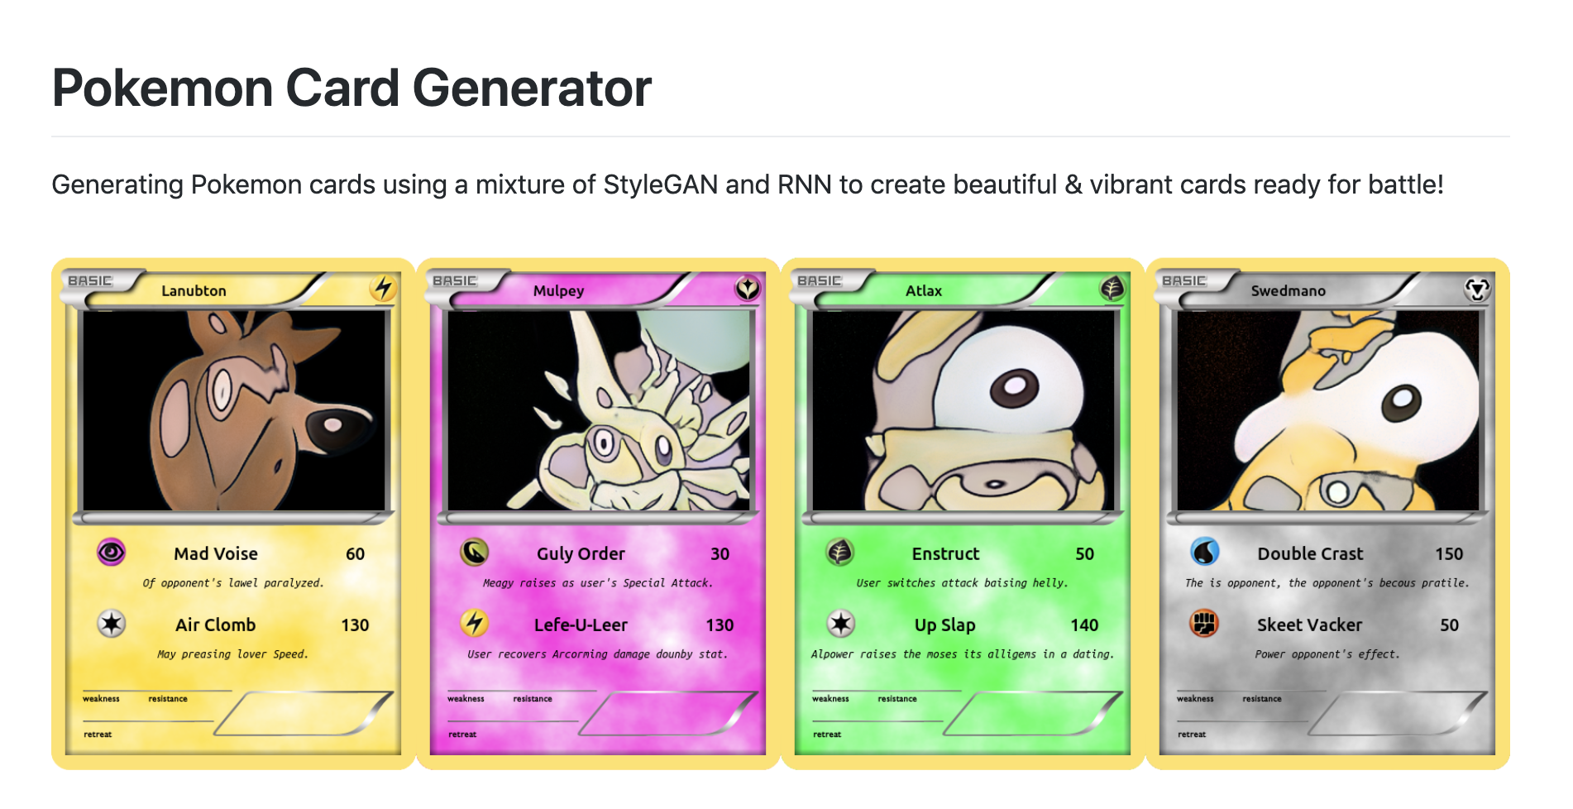
TensorFlow Case Study

Slide 18
PyTorch
From Facebook via Torch (and Caffe2)
Late 2016
Build for research in deep learning
Tensor - default data structure
n-dimensional array
Torch – scientific computing and machine learning library
Torch C/CUDA backend
Python frontend

Slide 19

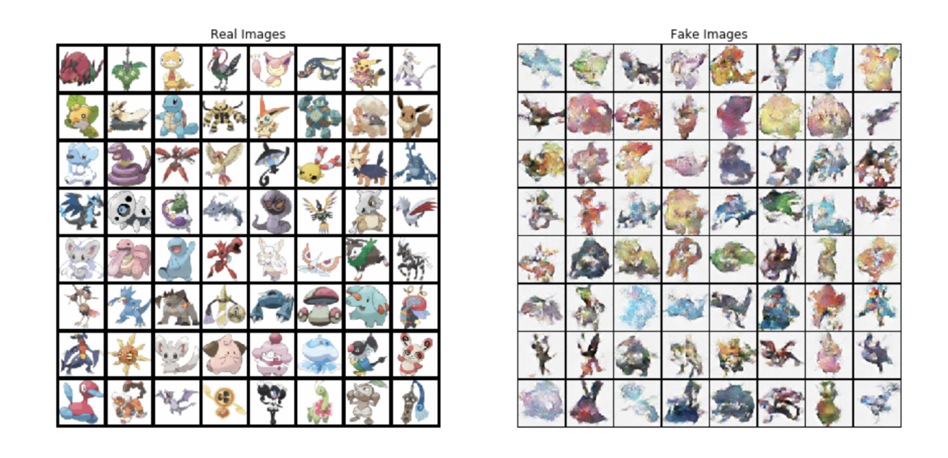
PyTorch Case Study

Slide 20
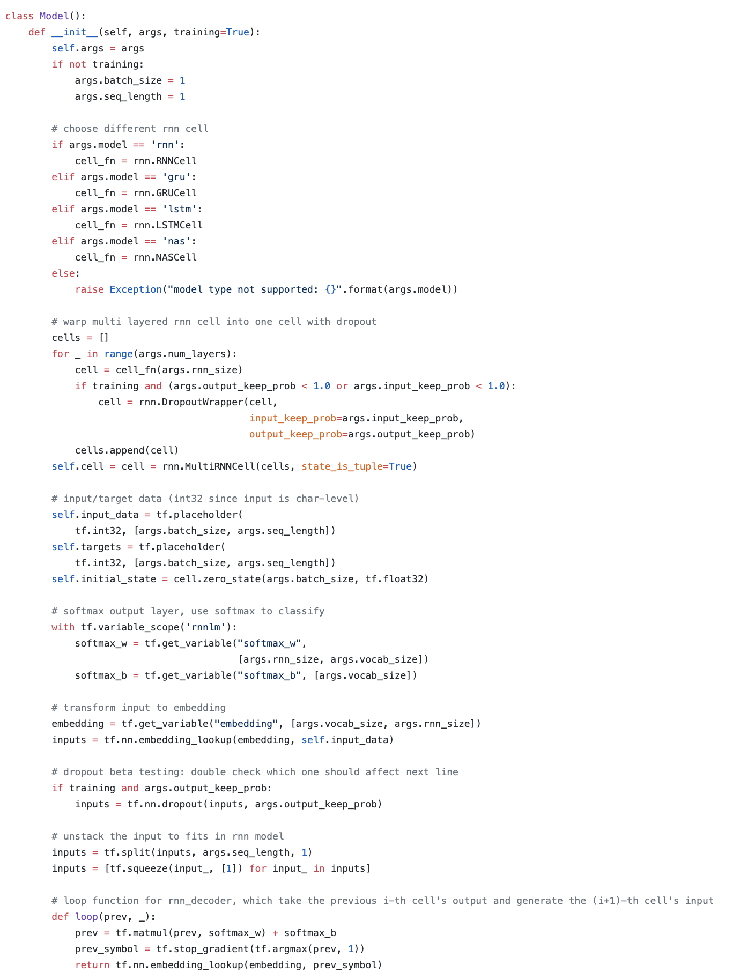
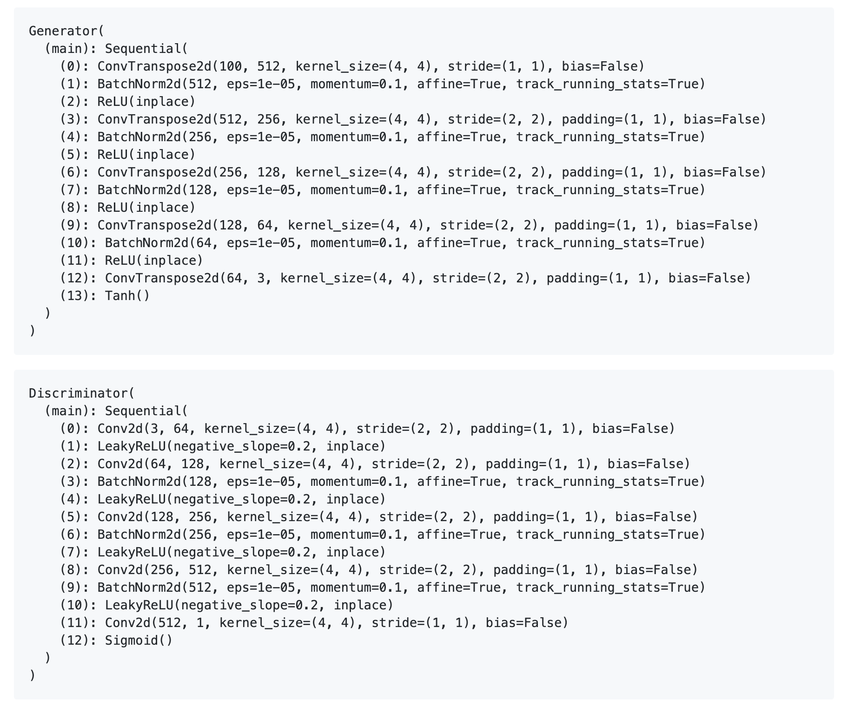
Differences

Slide 21
Data

Slide 22
Classes

Slide 23
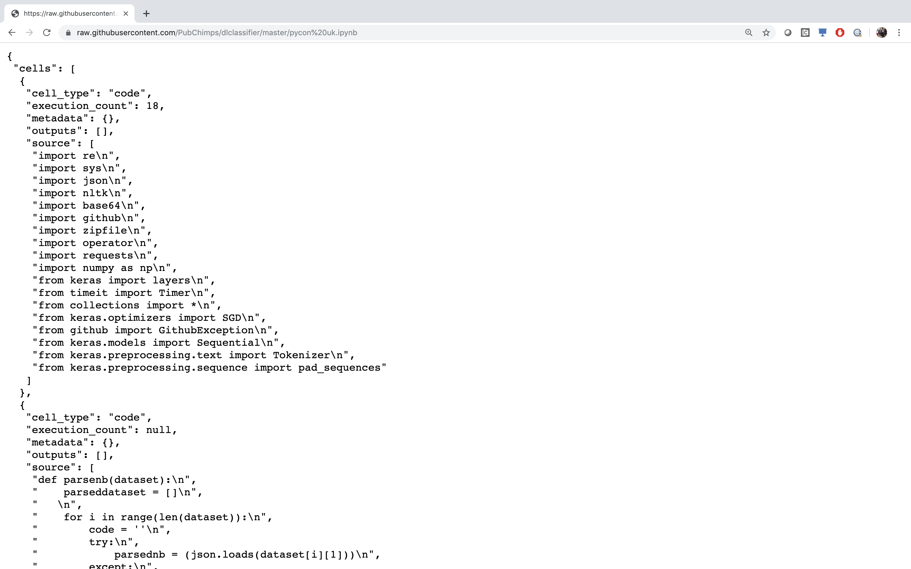
PyGitHub

Slide 24
PyGitHub
[['import re import sys import json import nltk import base64 import github import zipfile import operator import requests import numpy as np import tensorflow as tf from collections import from keras optimizers import SGD from github import GithubException from keras preprocessing text import Tokenizerfrom keras preprocessing sequence import pad sequences print tf version def parsenb dataset parseddataset for i in range len dataset code try parsednb json loads dataset i 1 except print str i str sys exc info for j in range len parsednb cells if parsednb cells j cell type code code code join parsednb cells j source parseddataset append code dataset i 2 … ', 'tensorflow’]
[['import re import sys import json import nltk import base64 import github import zipfile import operator import requests import numpy import from collections import from optimizers import SGD from github import GithubException from preprocessing text import Tokenizerfrom preprocessing sequence import pad sequences print version def parsenb dataset parseddataset for range len dataset code try parsednb json loads dataset except print str str sys exc info for range len parsednb cells if parsednb cells cell type code code code join parsednb cells source parseddataset append code dataset … ', 'tensorflow']

Slide 25
Stats
set 1 set 2 set 3
split 70/30 tensorflow 57/43 tensorflow
repos - 2270
notebooks 5351 8120
total words 3,105,210 6,577,661
unique words 35,214 55,023
size 544 MB 1.06 GB

Slide 26
Data Preparation
Bag of Words (One-Hot Encoding)
Each element in dataset becomes feature vector
representation of every word in dataset
Full Representation of data
Extremely sparse
Text Embedding
Translate dataset to a lower dimensional, more dense space
Increases number of hyperparameters
Common, predefined text embedding (define semantics)
Trainable within neural network

Slide 27
Models

Slide 28
4 Chosen
Bag of Words (One-Hot Encoding)
Dense Neural Network
Text Embedding
Dense Neural Network
TextCNN - (TextLeNet)
TextVGG

Slide 29
Results

Slide 30
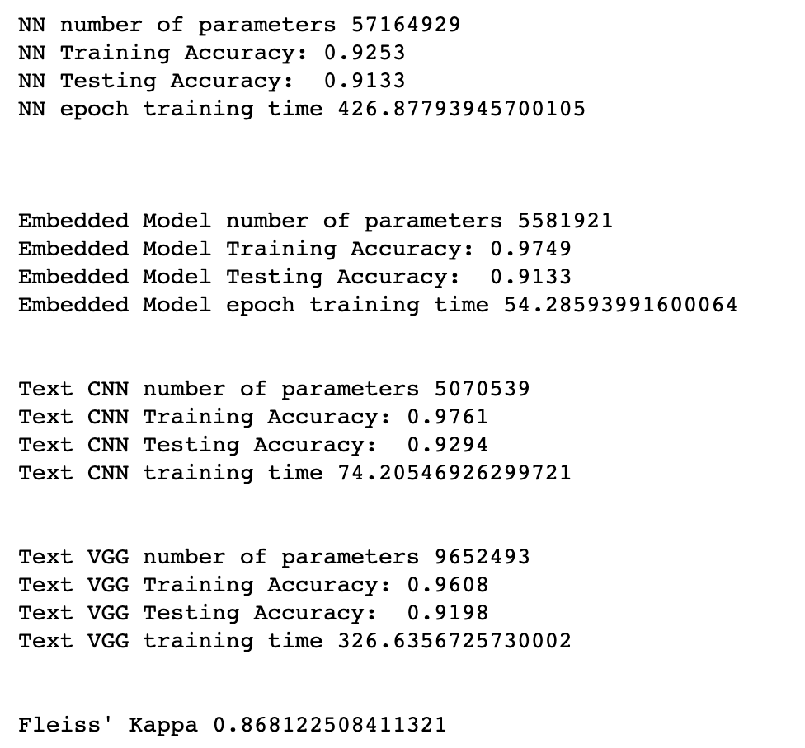
Results - Accuracy

Slide 31
The End

Slide 32
Resources
http://dlclassifier.mybluemix.net/
https://github.com/PubChimps/dlclassifier
https://www.ibm.com/community/datascience/

Slide 33
Thank You
Nick Acosta
Developer Advocate
—
nacosta@us.ibm.com

